Slide 1
Particle Collisions in One Dimension
Dr. Jacob Moore
Associate Professor of Engineering
Penn State Mont Alto

Slide 2
Steady Flow Devices
A steady flow device is any device that has a constant flow of material through it.
There are numerous applications of steady flow devices in engineering including…
Pipes
Nozzles
Diffusers
Pumps
Etc.

Slide 3
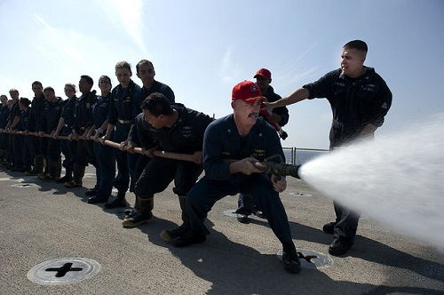
Steady Flow Devices
If this device alters the momentum of the fluid flowing through the device (either by altering the speed or the direction of the fluid flow) it will need to exert an impulse on the fluid to make this happen.

Slide 4

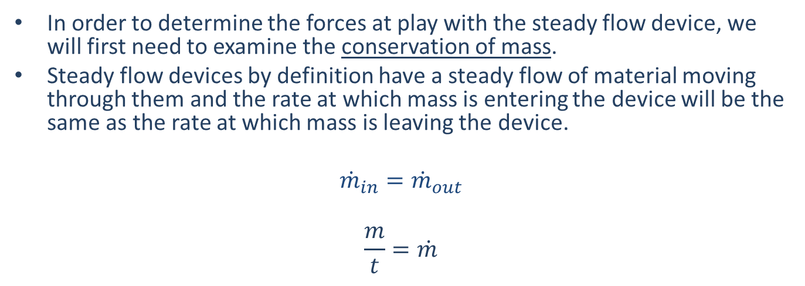

Analysis of Steady Flow Devices
In order to determine the forces at play with the steady flow device, we will first need to examine the conservation of mass.
Steady flow devices by definition have a steady flow of material moving through them and the rate at which mass is entering the device will be the same as the rate at which mass is leaving the device.
$${\dot{m}}_{in}={\dot{m}}_{out}$$
$$\frac{m}{t}=\dot{m}$$
$${\dot{m}}_{in}$$
$${\dot{m}}_{out}$$

Slide 5
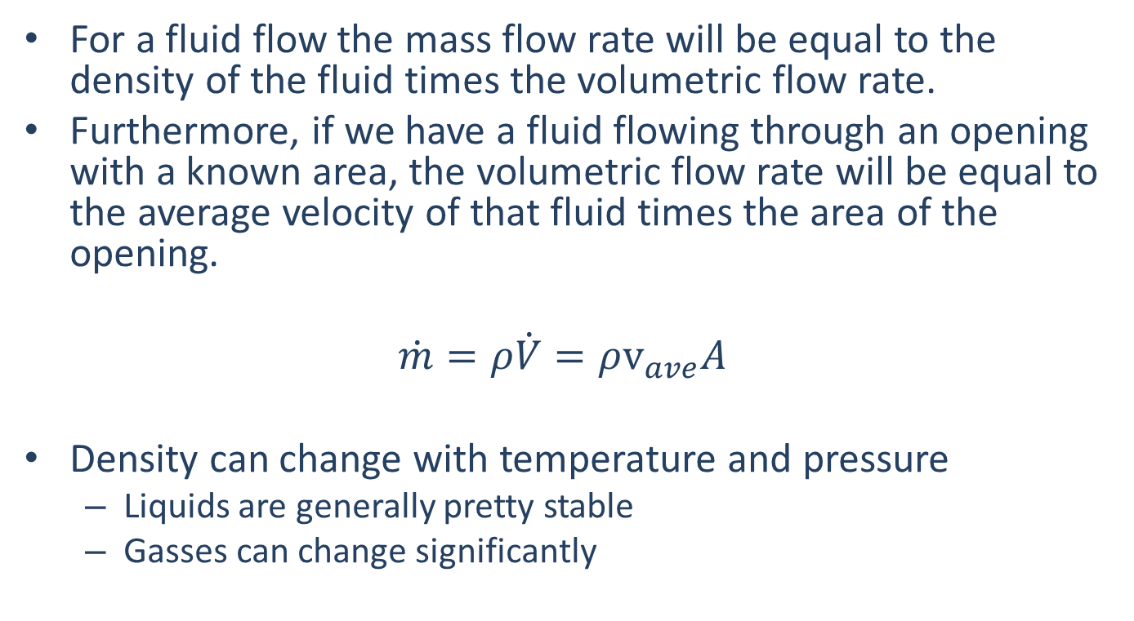
The Mass Flow Rate
For a fluid flow the mass flow rate will be equal to the density of the fluid times the volumetric flow rate.
Furthermore, if we have a fluid flowing through an opening with a known area, the volumetric flow rate will be equal to the average velocity of that fluid times the area of the opening.
$$\dot{m}=ρ\dot{V}=ρv_{ave}A$$
Density can change with temperature and pressure
Liquids are generally pretty stable
Gasses can change significantly

Slide 6

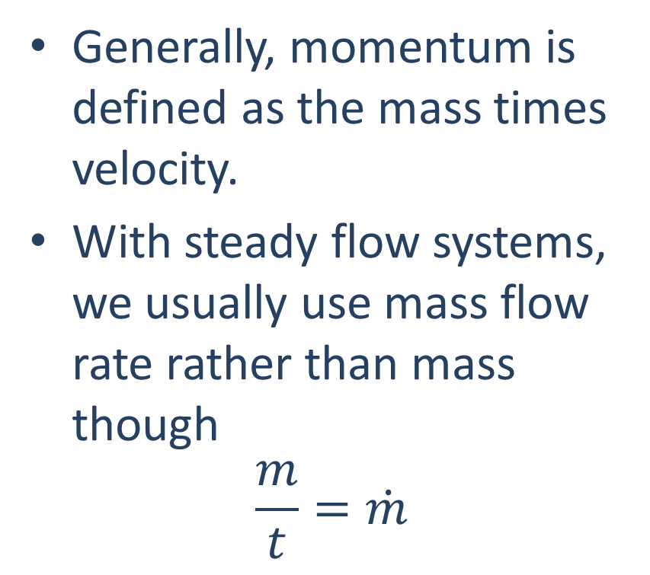


Momentum in Steady Flows
Generally, momentum is defined as the mass times velocity.
With steady flow systems, we usually use mass flow rate rather than mass though
$$\frac{m}{t}=\dot{m}$$
$$\dot{m}$$
$$v_{in}$$
$$v_{out}$$

Slide 7
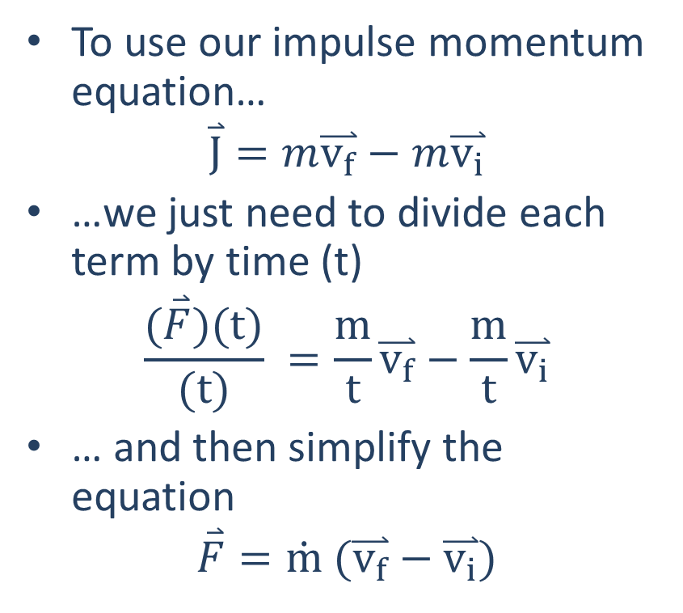
Momentum in Steady Flows
To use our impulse momentum equation…
$$\overset{⃑}{J}=m\overset{⃑}{v_{f}}−m\overset{⃑}{v_{i}}$$
…we just need to divide each term by time (t)
$$\frac{(\overset{⃑}{F})(t)}{(t)} =\frac{m}{t}\overset{⃑}{v_{f}}−\frac{m}{t}\overset{⃑}{v_{i}}$$
… and then simplify the equation
$$\overset{⃑}{F}=\dot{m} (\overset{⃑}{v_{f}}−\overset{⃑}{v_{i}})$$
$$\dot{m}$$
$$v_{in}$$
$$v_{out}$$

Slide 8
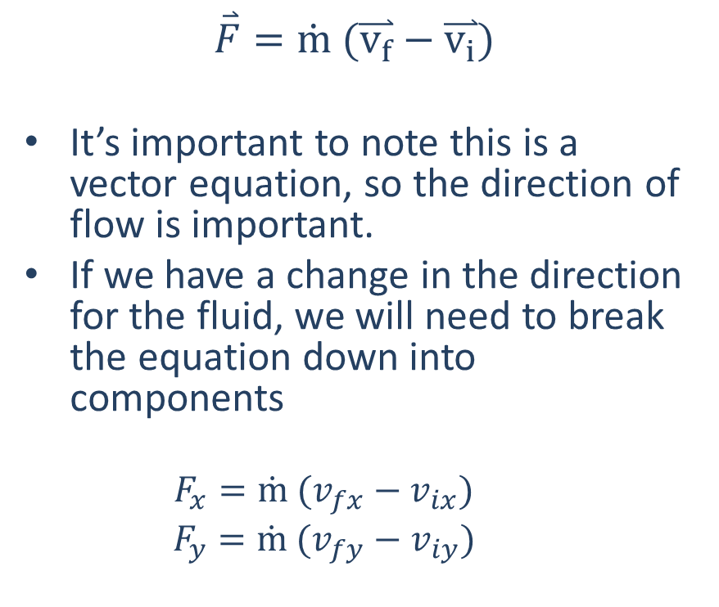
Momentum in Steady Flows
$$\overset{⃑}{F}=\dot{m} (\overset{⃑}{v_{f}}−\overset{⃑}{v_{i}})$$
It’s important to note this is a vector equation, so the direction of flow is important.
If we have a change in the direction for the fluid, we will need to break the equation down into components
$$F_{x}=\dot{m} (v_{fx}−v_{ix})$$
$$F_{y}=\dot{m} (v_{fy}−v_{iy})$$

Slide 9


Momentum in Steady Flows
It’s also important to note this final conservation on momentum equation gives us the force the device would need to exert on the fluid in order to change it’s momentum.
The force of the fluid on the device is equal and opposite to this force
$$F_{water on pipe}$$
$$F_{pipe on water}$$

Slide 10
Thanks for Watching
See other engineering mechanics videos and access the full tool at…

Slide 11
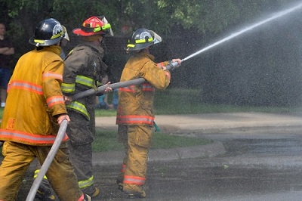
Worked Example
A fire fighter supports a hose as shown below. The hose has a volumetric flow rate of 60 gal/min and the nozzle reduces in diameter from 4 cm to 2 cm. What force will the fire fighter have to exert, in Newtons, to keep the hose in place?

Slide 12
Worked Example
A 90-degree elbow joint redirects the flow along a 3 cm diameter pipe. If water (density=1000 kg/m³) is traveling through the pipe with an average speed of 5 m/s, what is the magnitude and direction of the force the water exerts on the elbow joint?

